Slide 1
Lowkey!

Slide 2
The Problem
Artists not getting enough recognition
Listeners are unable to find new music to listen too

Slide 3
The Solution
Need a platform where users can discover music by unknown artists

Slide 4
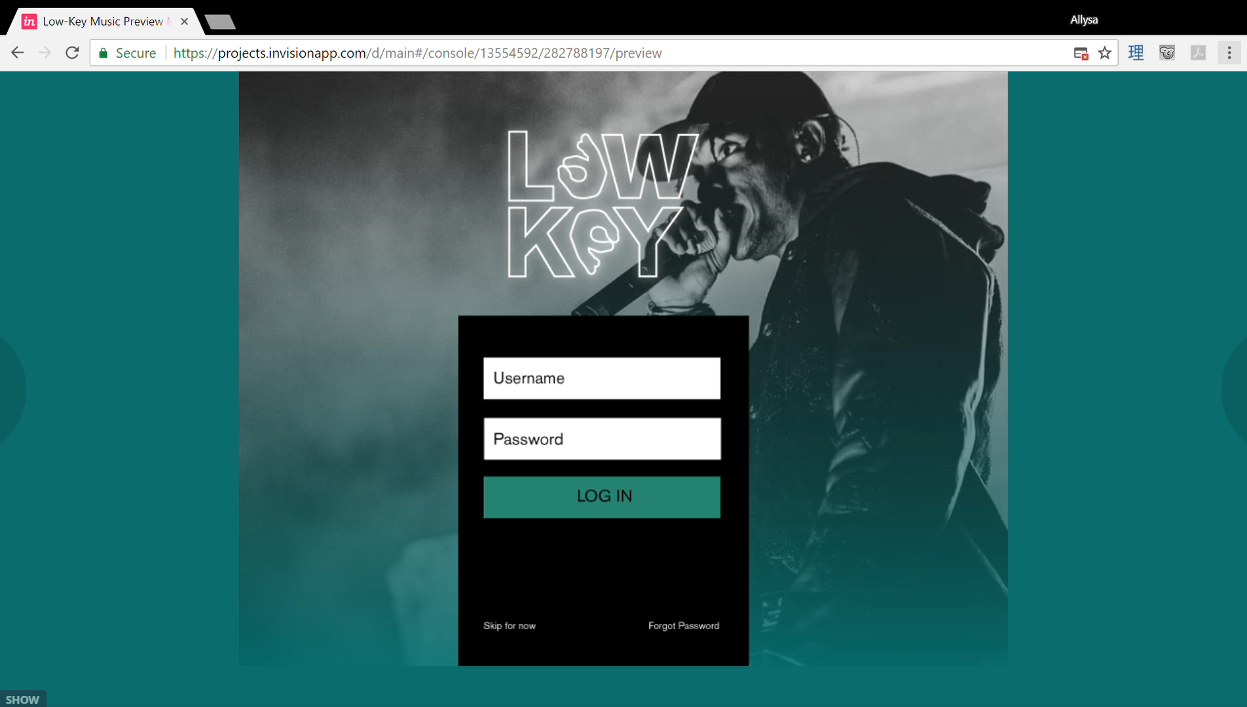
Where we come in
Website allows artists to link their songs from Spotify for users to see

Slide 5
Monetization
Advertisements
Artist subscriptions

